Slide 1
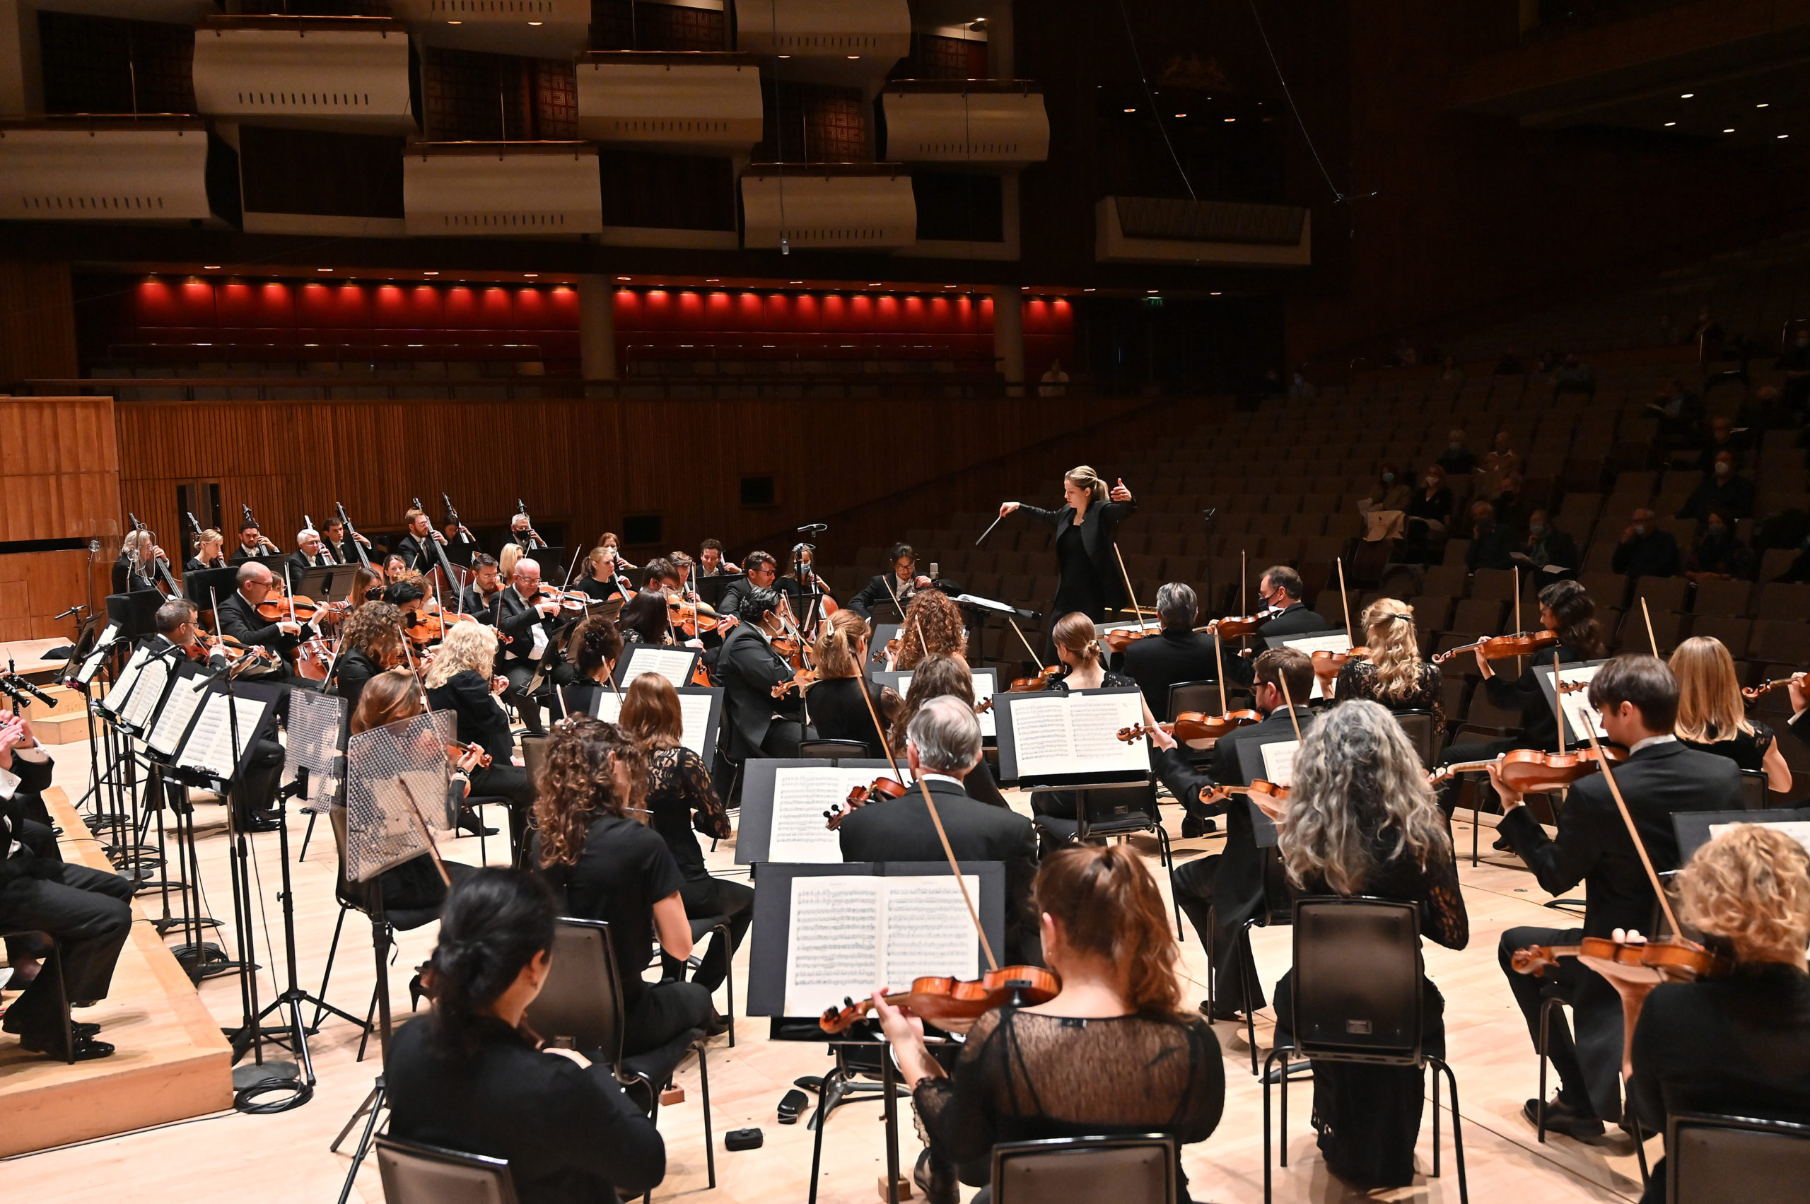
GCSE BrightSparks
Resources
BrightSparks is generously funded by the Rothschild Foundation with additional support from the Candide Trust, Dunard Fund, Rivers Foundation, The R K Charitable Trust, Mr & Mrs Philip Kan, Gill and Julian Simmonds
© Rachel Leach and the London Philharmonic Orchestra 2023

Slide 2
A guide to
The Classical Symphony

Slide 3
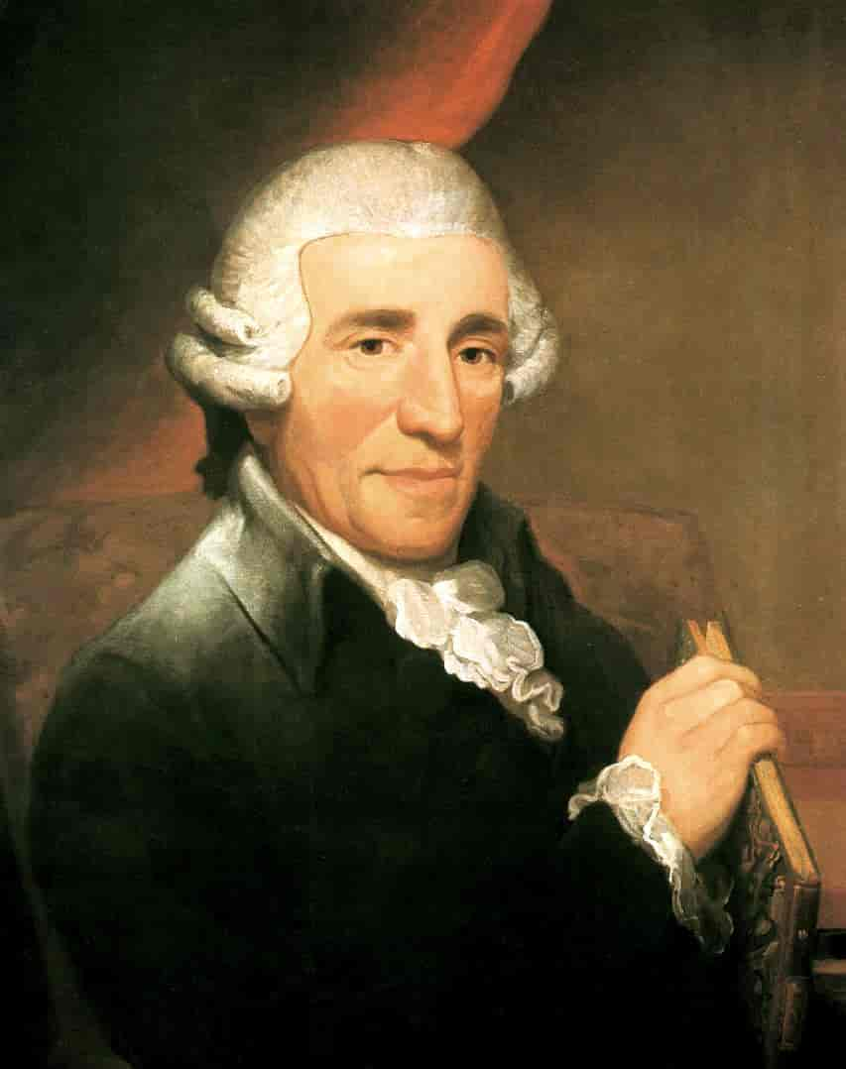
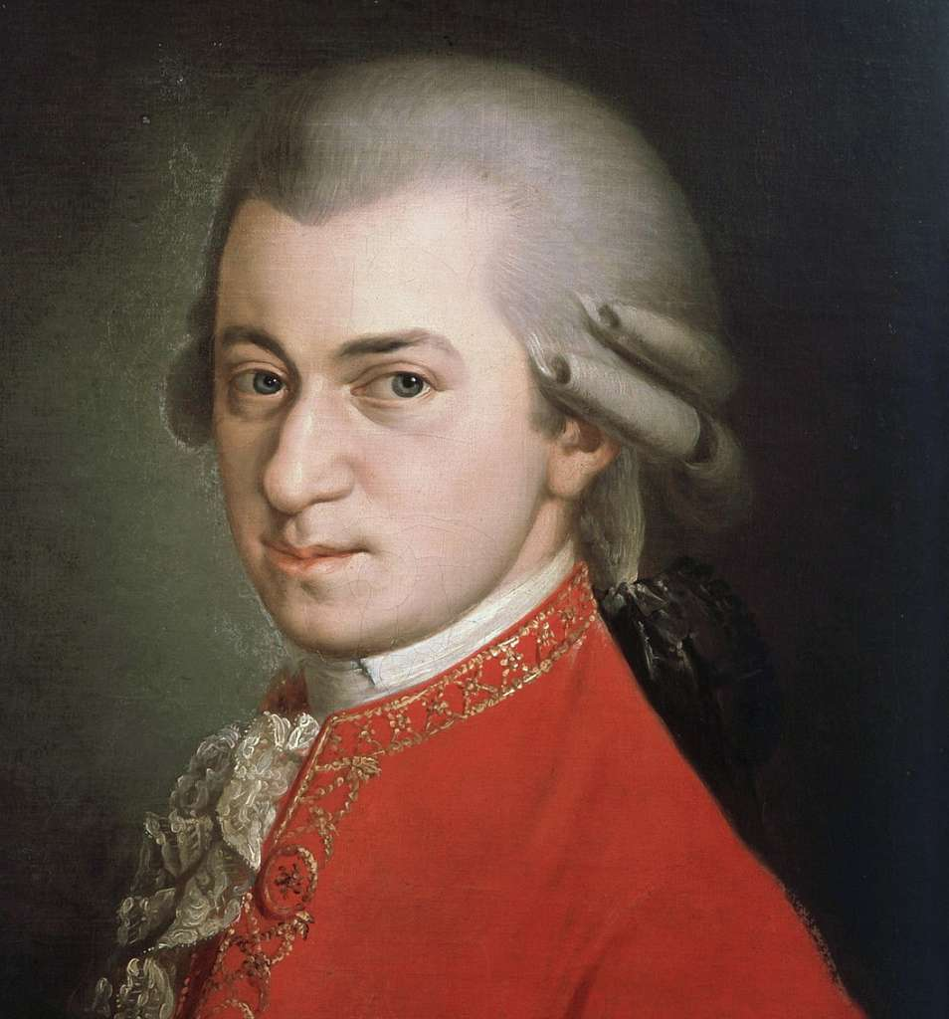
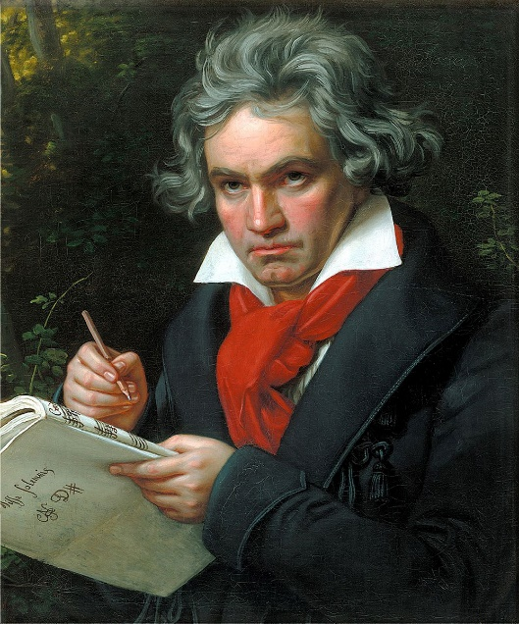
Classical period (c.1730–1830)
Music was shaped into perfect structures, defined by a system of harmonic rules
Use of balanced, regular phrasing
Key composers:
Franz Joseph Haydn (1732–1809)
‘The father of the symphony’
Wolfgang Amadeus Mozart
(1756–1791)
Ludwig van Beethoven
(1770–1827)

Slide 4
What is a symphony?
A large piece for orchestra, often in 4 movements (sections). Typically:
Movement 1: Fast, in sonata form
Movement 2: Slow
Movement 3: Dance (often Minuet and trio)
Movement 4: Fast
Let’s explore this through Beethoven’s Symphony No. 5…

Slide 5
Ludwig van Beethoven (1770–1827)
Symphony No. 5 (1808)
Also known as the ‘Fate Symphony’
One of the best-known compositions in classical music and one of the most frequently performed symphonies
Described as “one of the most important works of the time”

Slide 6
What is a sonata form?
Sonata form is the structure usually used in the first movement of a Classical symphony
It has 3 or 4 sections:
Exposition – featuring 2 ‘subjects’ (musical ideas)
Development – the musical ideas combine, develop, and the harmony becomes more complex
Recapitulation – an altered repeat of the Exposition. This section takes us back to the tonic key
Often there is also a Coda – an ending section firmly establishing the tonic/home key, ending in a big perfect cadence (V-I)

Slide 7
First movement – Sonata form – First Subject
The first movement of a Classical symphony is usually in Sonata form
This means it usually features three sections and two subjects (tunes)
Beethoven’s first subject is huge, daunting, and sounds immediately important
It is sometimes described as the sound of fate knocking on your door
It’s extremely famous because it is so loud, dramatic and memorable
This subject recurs throughout the piece (including in the bassline and as an accompaniment)

Slide 8
First movement – Sonata form – Second subject
In sonata form, the second subject tends to contrast with the first subject
Beethoven’s second subject is a smooth, wandering tune that moves up and down like a snake
As it is played, you can hear the rhythm of the first subject in the bassline
The second subject is introduced by the horns playing very loudly (forte)

Slide 9
Beethoven Symphony No.5 First movement – Sonata form
Exposition (bars 1–124) – features first and second subjects
Development (bars 125–253) – announced by the horns. The two subjects combine, interact and converse
Recapitulation (bars 254–375) – a return to the Exposition section, but with some differences (including an additional oboe solo)
Coda (bars 370–end) – an elaborate ending that helps to re-establish the key (C minor). Features many perfect cadences at the end (Chord V – I)

Slide 10
Beethoven Symphony No. 5: I. Allegro con brio
Start Slide Show to play video

Slide 11
Second movement
Second movements are slow
Beethoven’s is marked Andante con moto (walking pace with movement)
Second movements often features beautiful melody with ornamentation
Ornamentation = trills, grace notes, little ‘twiddles’ that decorate the melody
Beethoven Symphony No. 5: II. Andante con moto

Slide 12
Third movement
Third movements are a dance
Usually a Minuet and Trio – a dance in 3 with a contrasting ‘trio’ section
Beethoven uses Scherzo and Trio here, which is light-hearted and fun, and also has a contrasting trio section
Beethoven Symphony No. 5: III. Scherzo: Allegro

Slide 13
Fourth movement
Fouth movements are fast, flashy and fabulous!
Often in sonata form or rondo form. (Rondo form features a theme that keeps returning, interspersed with ‘episodes’. So the structure is A-B-A-C-A etc.)
Beethoven’s fourth movement is in sonata form
Often ends with a large coda and perfect cadences
Beethoven Symphony No. 5: IV. Allegro

Slide 14
Further listening:
Franz Joseph Haydn – Symphony No. 99 (1793)
Louise Farrenc – Symphony No. 3 (1847)
Johannes Brahms – Symphony No. 4 (1885)
Antonin Dvořák – Symphony No. 9 (‘From The New World’) (1893)
Gustav Mahler – Symphony No. 2 (‘Resurrection’) (1895)
William Grant Still – ‘Afro-American’ Symphony No. 1 (1930)
Florence Price – Symphony No. 1 (1932)
Dmitri Shostakovich – Symphony No. 5 (1937)
As you listen, see if you can identify the structures, and how the symphony developed from the Classical to the modern period

